Slide 1

CRIME INCIDENTS 2012-2014
Data Science Project
Yvonne

Slide 2
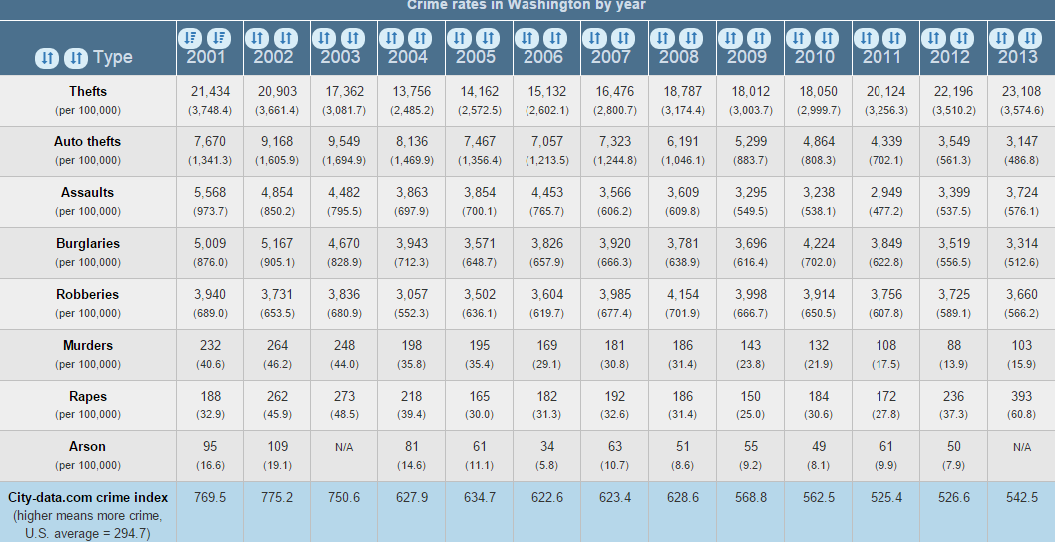
DC has been for many years above the average U.S. Crime Rate
Source: City-data.com

Slide 3
QUESTION:
IS IT POSSIBLE TO PREDICT THE TIMEFRAME FOR THE HIGHEST ROBBERY RATE FOR 2015 IN DC?

Slide 4
DATA THAT HAS BEEN GATHERED:
Crime Incidents 2012
Crime Incidents 2013
Crime Incidents 2014
These 3 datasets can be found through OCTO (download into a csv)
Employment Information 2012
Employment Information 2013
Employment information 2014
Dataset can be found at DOES.

Slide 5
DATA CLEANING AND EXPLORATION
Imported the Crime Incidents data
Since the date was in y/m/d/t I split the column to just the year for now. (I might split it later down to m/d/y)
I renamed the column that I know I want to work with.
I combined the Crime_Incident 2012, 2013 and 2014
Surprisingly Ward 4 had an increase over 700 crime incidents from 2012 to 2014, while Ward 8 crime incidents went down
It appears that the evening shift has a higher crime rate, you can also see that the crime rate increased from 2012 to 2014
I combined Employment Data, added the year to each file.
The Employment Data does give me the Ward information to join it with the crime incident data

Slide 6
CRIME INCIDENTS BY WARD PER YEAR
WARD | 2012 | 2013 | 2014
1 | 5058 | 5407 | 5408
2 | 6537 | 5950 | 6775
3 | 1781 | 1934 | 1824
4 | 3001 | 3262 | 3796
5 | 4795 | 4611 | 5379
6 | 5512 | 5669 | 6023
7 | 4344 | 4613 | 5108
8 | 4398 | 4433 | 4074

Slide 7
CRIME INCIDENTS IN A SHIFT PER YEAR
SHIFT | 2012 | 2013 | 2104
Evening | 14686 | 15154 | 16279
Day | 14436 | 14092 | 15248
Midnight | 6307 | 6636 | 6861

Slide 8
Crime Offenses in a Year
OFFENSE | 2012 | 2013 | 2014
THEFT/OTHER | 12480 | 12888 | 14628
THEFT F/AUTO | 9463 | 10131 | 11285
ROBBERY | 4268 | 4071 | 3333
BURGLARY | 3680 | 3369 | 3184
MOTOR VEHICLE THEFT | 2863 | 2675 | 3119
ASSAULT W/DANGEROUS WEAPON | 2295 | 2310 | 2398
SEX ABUSE | 257 | 299 | 309
HOMICIDE | 88 | 104 | 106
ARSON | 35 | 35 | 26

Slide 9
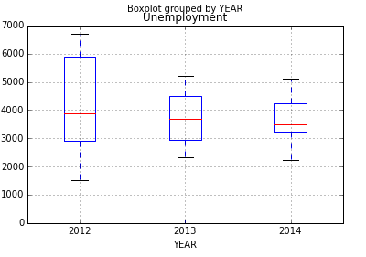
UNEMPLOYMENT RATE BY YEAR

Slide 10
Insight which has been gained after looking into the DATA
After importing the Employment information, I come to realize I will have to get the average of the Employment a year in order to work with the crime incident data on a yearly basis or I will have to break down the crime incident data to the monthly as well.
My previous question was: Can you predict the timeframe for the highest robbery crime rate in 2015. I will try to stay with that question, but I do want to get more information from the employment data. I am also considering adding race and ethnicity to get a better answer to the question
Found out that unemployment rate on the high-level does not play a roll in crime. I plan to go deeper into it to Ward and Month to confirm that this statement is true

Slide 11
TO BE CONTINUED…

